Slide 1


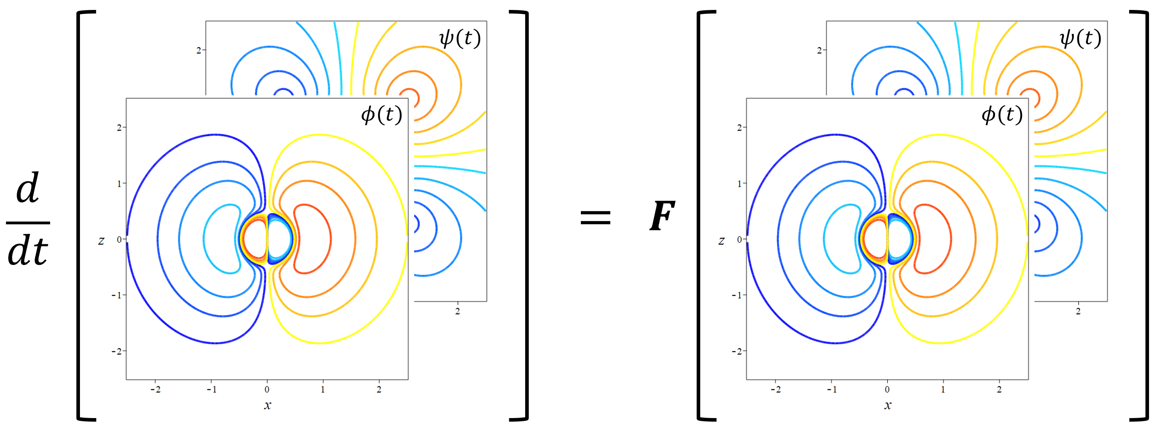
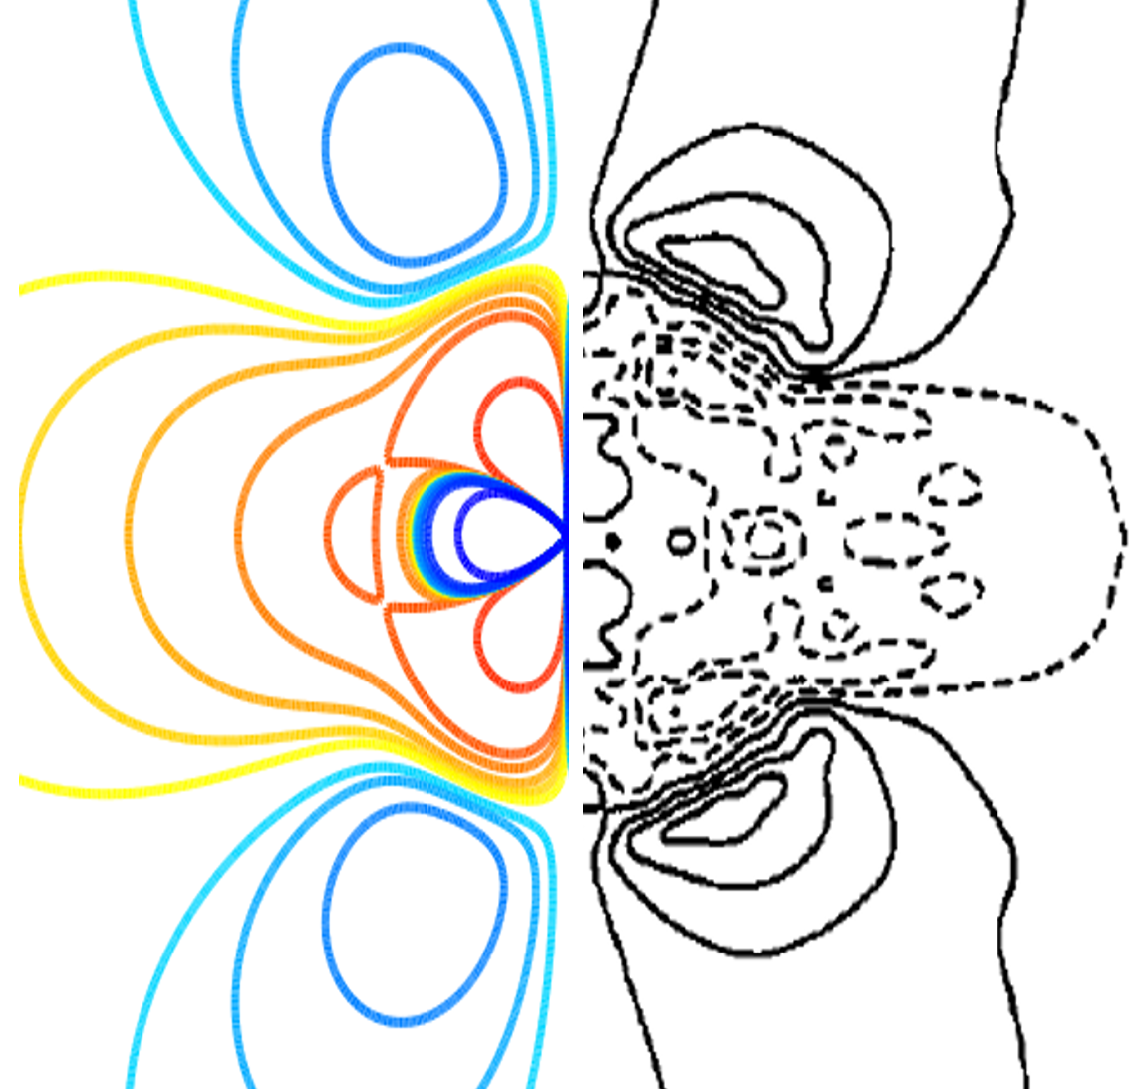
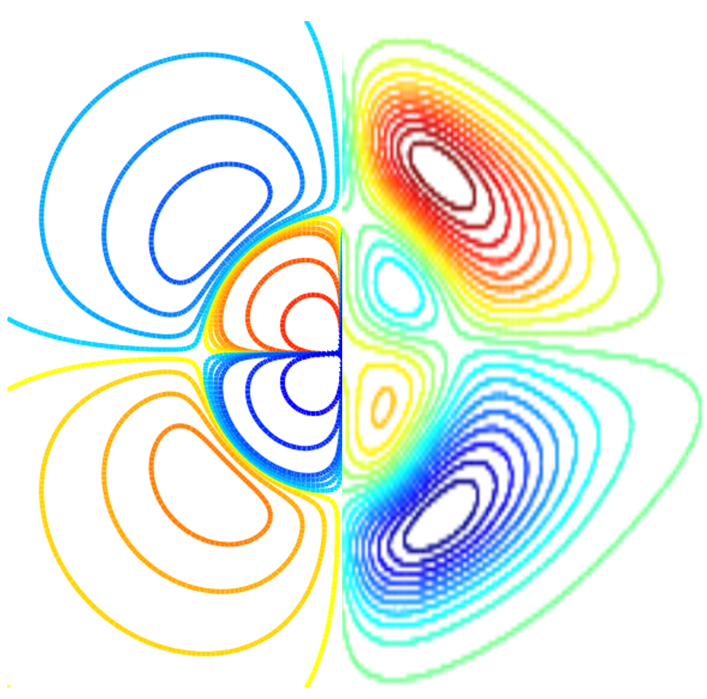
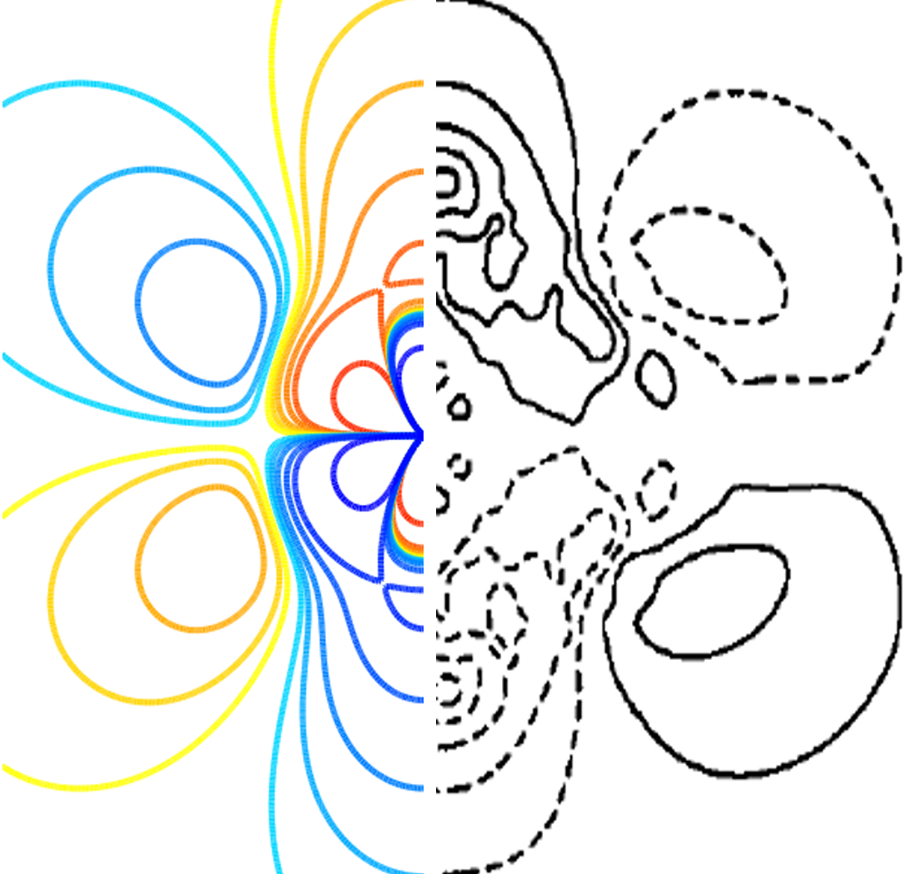
Hybrid-twin synthesis
Wang Zhe (zhe.wang@cnrsatcreate.sg)
Claude Guet (cguet@ntu.edu.sg)

Slide 2
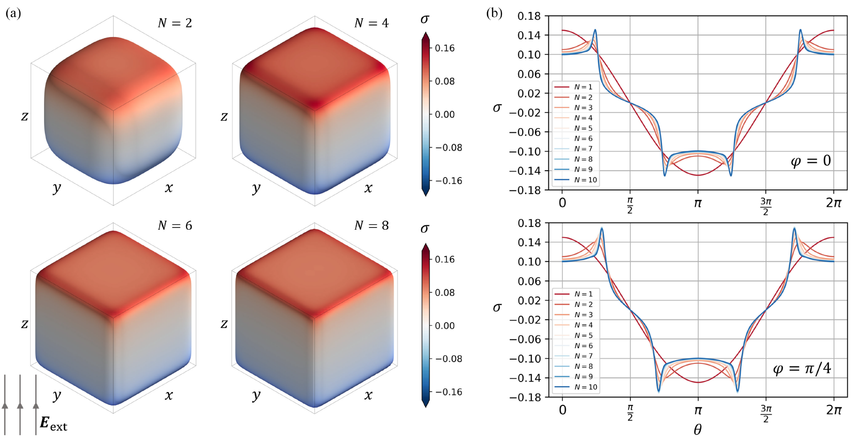
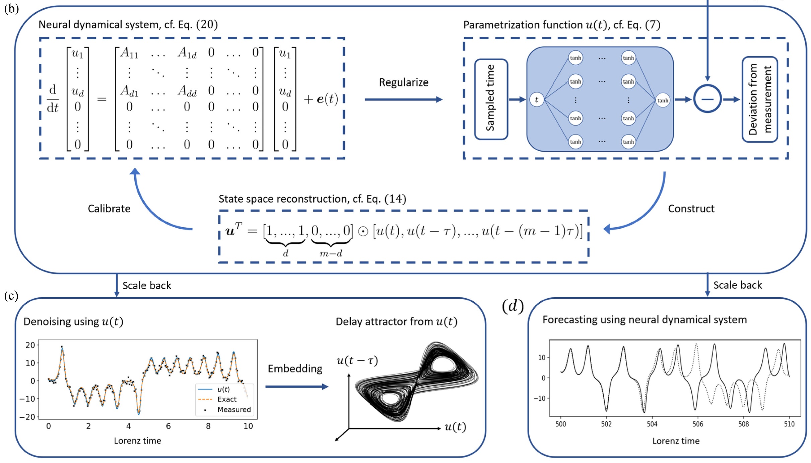
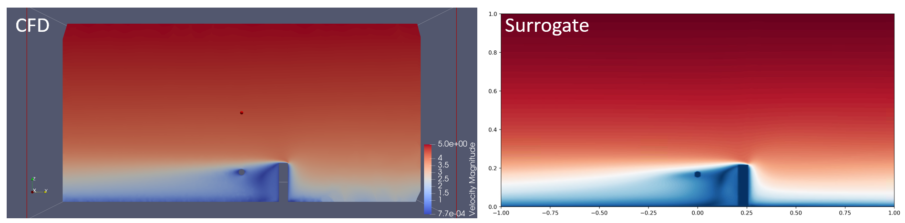
Overview
Hybrid-twin in our narrow point of view
Hybrid-twin = physics + neural networks
Physics: governing equations, boundary conditions, symmetries and other equality and/or inequality constraints.
Neural networks: nonlinear, deterministic, continuous, differentiable functions that map given input to desired outputs.
+: the physics can be incorporated as an ansatz or as loss functions.
Problem classification
Physics is completely known. convert initial-boundary value problems of differential equations into a minimization of loss function.
Physics is completely unknown: identify hidden governing equations from incomplete/noisy data.
Physics is partly known: calibrate a surrogate model for fast simulation.

Slide 3
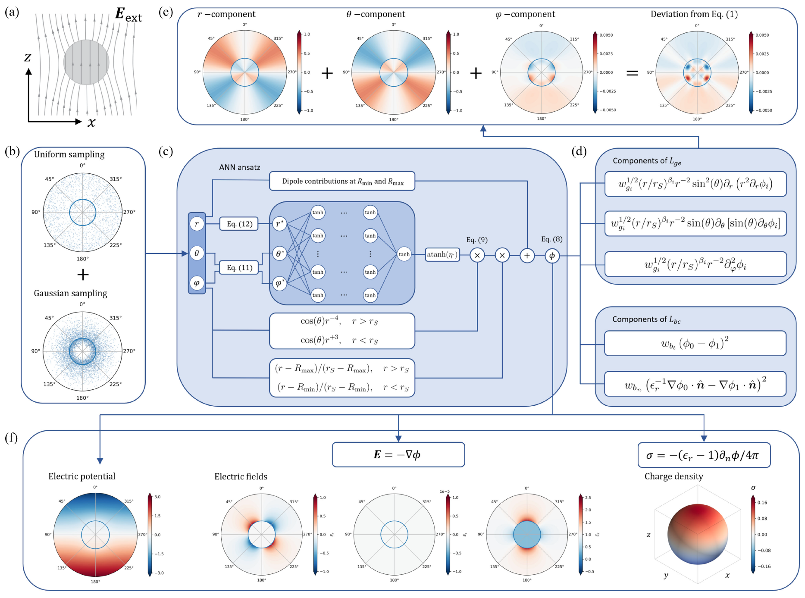
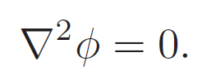
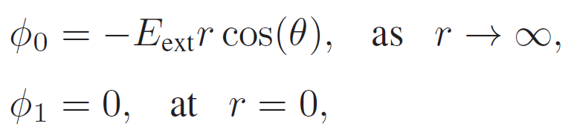
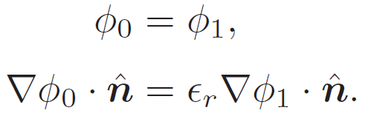
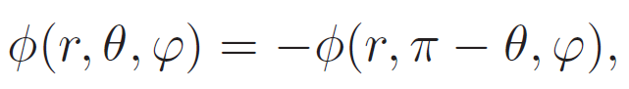
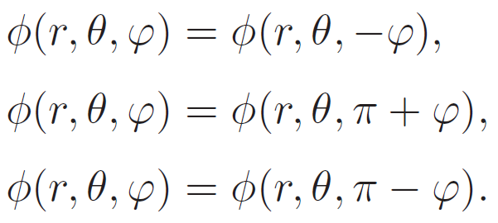
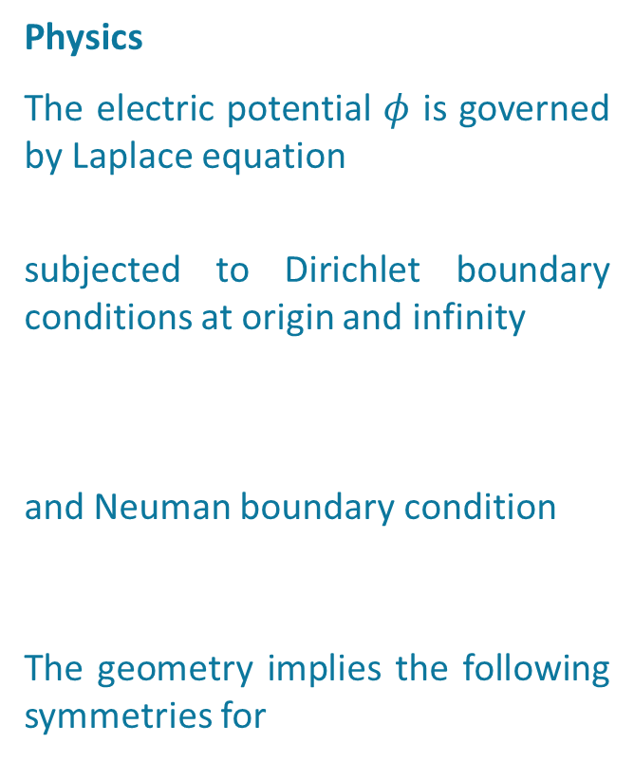
Case 1: Dielectric quasi-cube in a uniform electric field
Physics
The electric potential $φ$ is governed by Laplace equation
subjected to Dirichlet boundary conditions at origin and infinity
and Neuman boundary condition
The geometry implies the following symmetries for

Slide 4
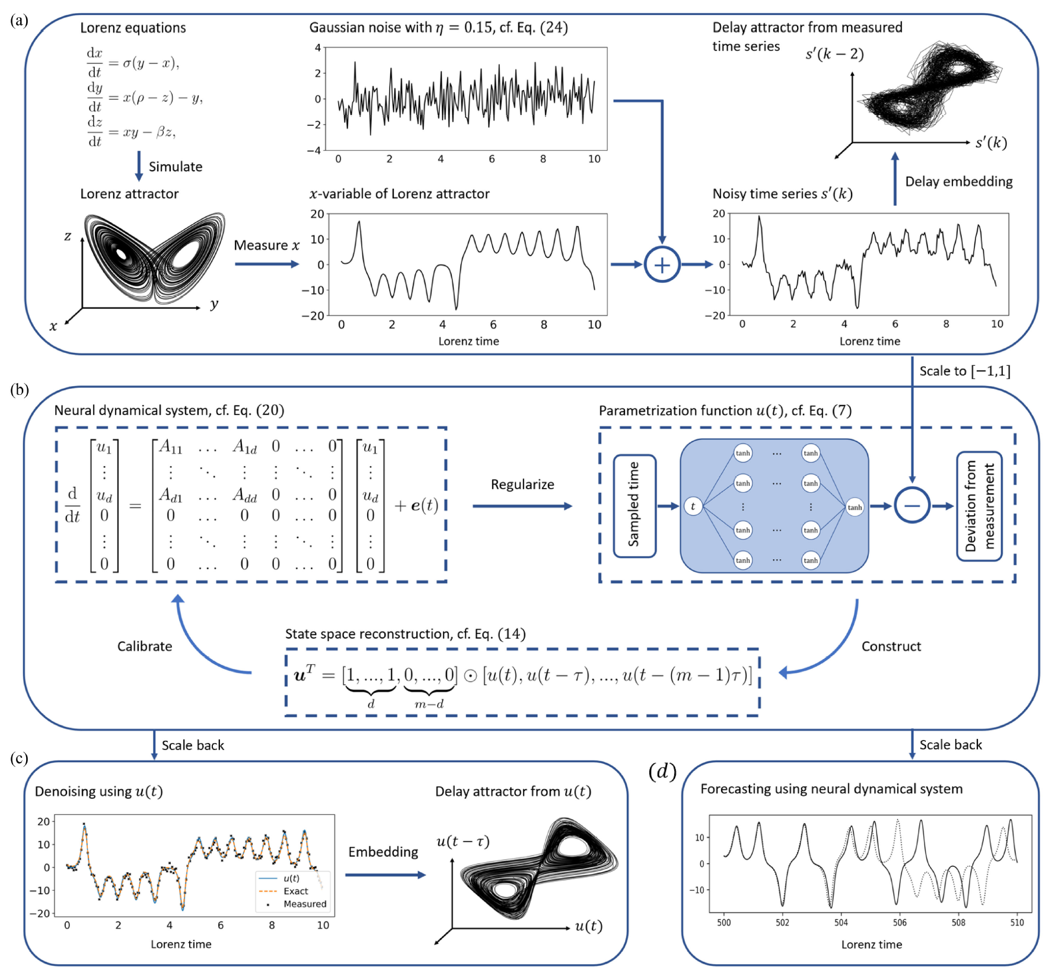
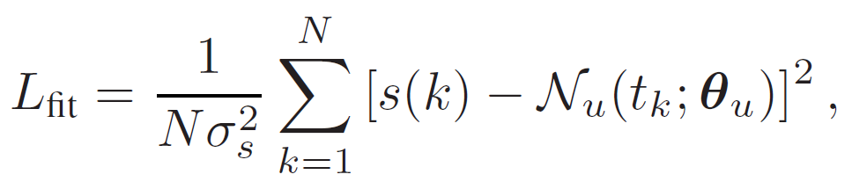
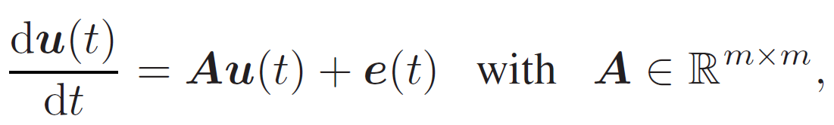
Case 2: Learning hidden neural dynamical system from noisy time series
Physics
Time series is a function of time
Deterministic time series is a projection of solution trajectories of a state vector onto the real axis.
Objective: recover from a noisy, incomplete observation of time series the underlying dynamical system that generates the time series.
Our approach
Since time series is a function of time
Assuming that the time series is generated by an unknown dynamical system

Slide 5

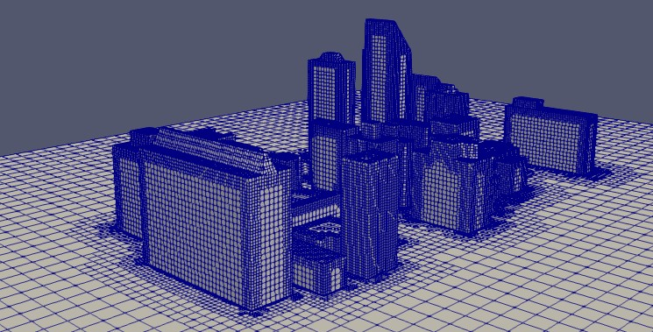
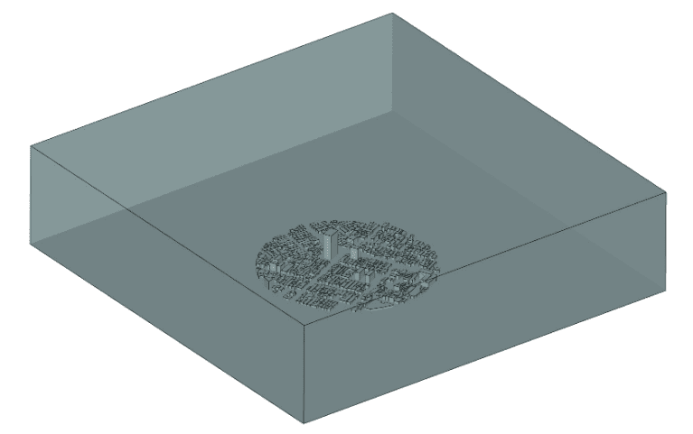
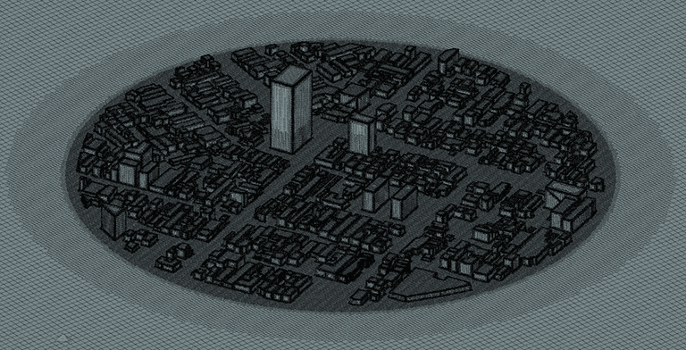
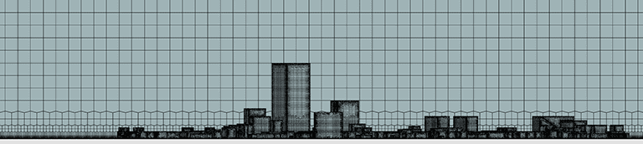
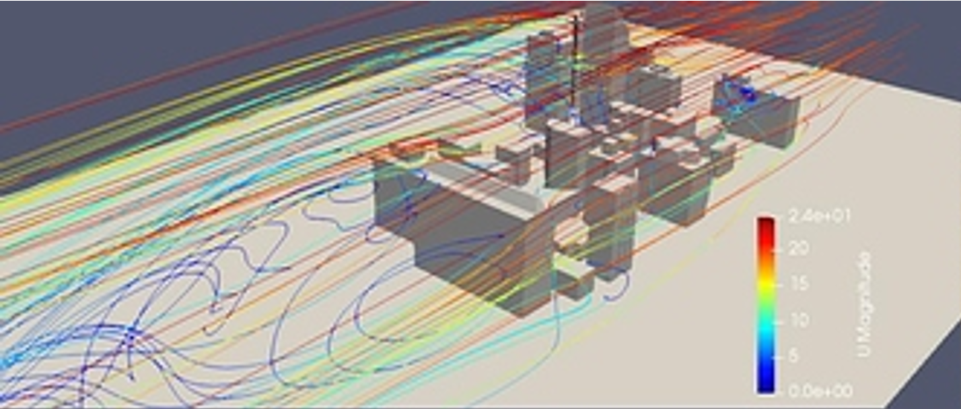
Case 3: Surrogate model for urban wind field
Objectives
For wind field in urban environment, we aim to provide a swift and precise
1. Filtering of measurement from sensors
2. Assimilation of filtered data with the physics equations
3. Forecasting and simulation.
Challenges (from our point view)
Mesh & boundary conditions: -> mesh-free/data-driven
Governing equations: -> surrogate model
Numerical difficulties associated with the Navier-Stokes equations.
CAD
Mesh
Far-field/meteorological
No-slip boundary condition on the walls
CFD

Slide 6
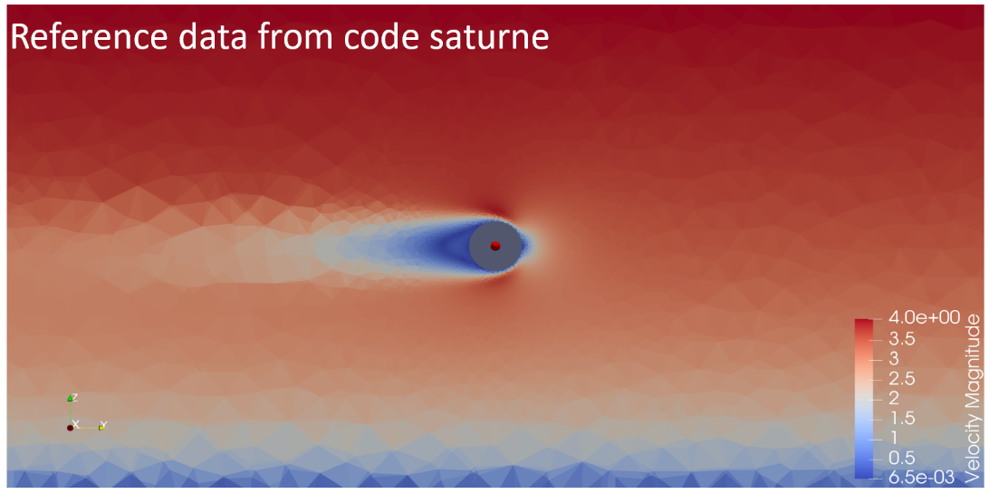
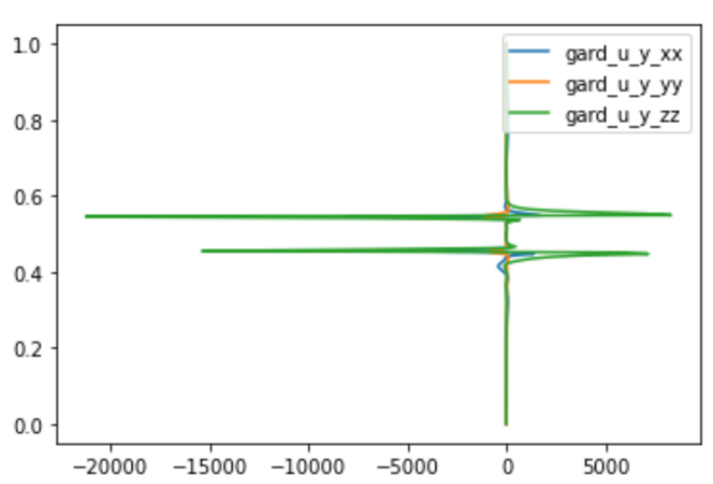
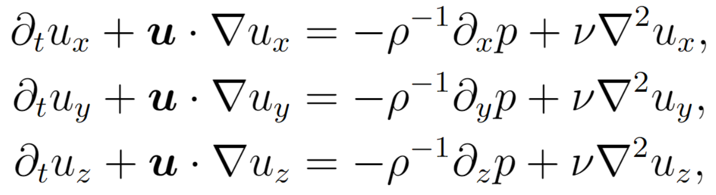
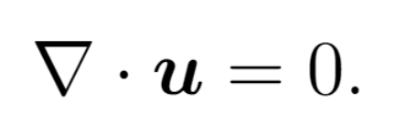
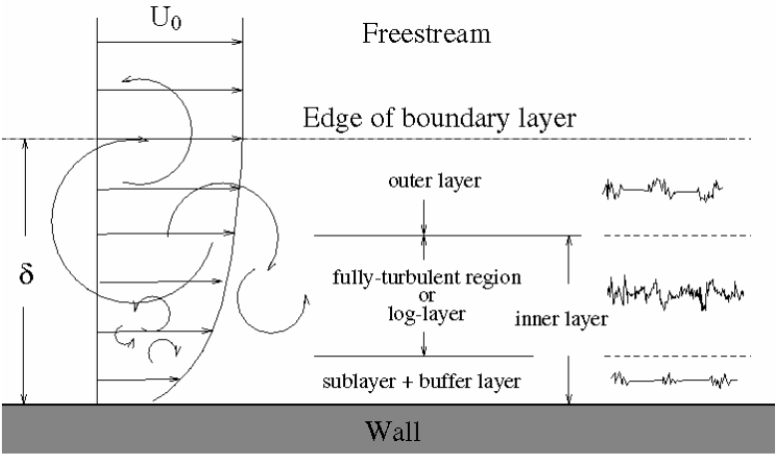
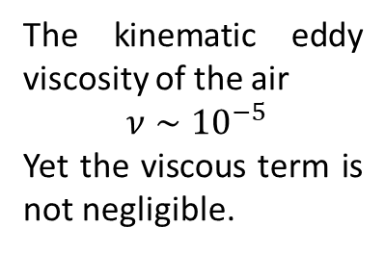
Navier-Stokes equations in urban environment
Remark on practicality
Navier-Stokes equations
Momentum
Continuity
Physical boundary conditions:
Canopy: meteorology
Border: zero velocity gradient
Walls: zero velocity
Comments:
The implementation of physical boundary conditions requires the wind field to reach a steady state, leading to a large size of the computation domain.
Urban wind field can be viewed as a superposition of an analytical vertical profile, where the freestream velocity is given by the meteorology, and a perturbation.
The kinematic eddy viscosity of the air
$ν∼{10}^{−5}$
Yet the viscous term is not negligible.
Meteorological data
Canopy of the city

Slide 7
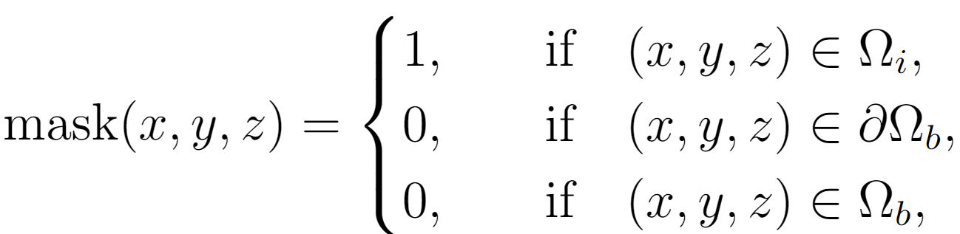
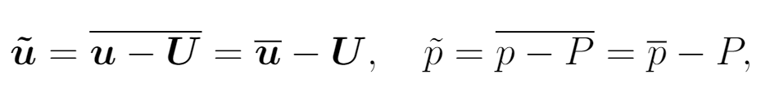
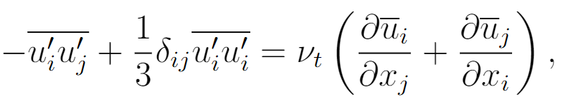
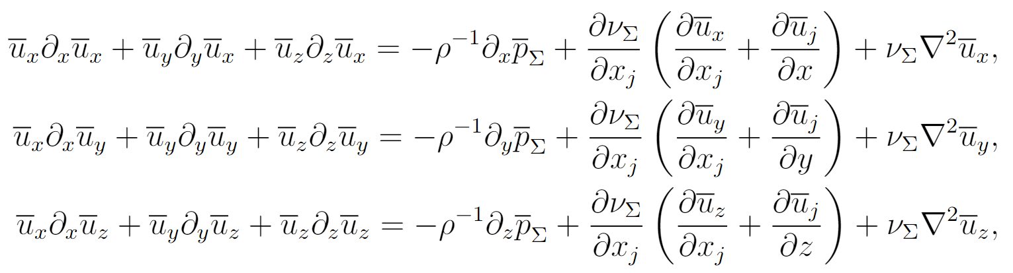
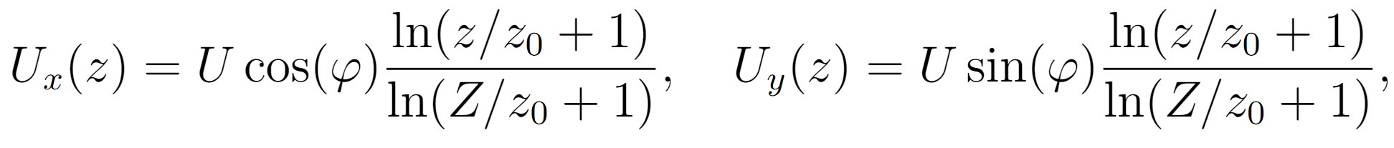
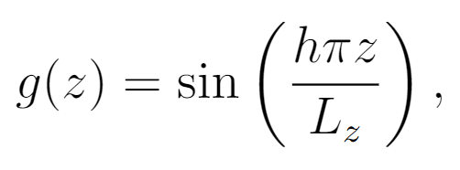
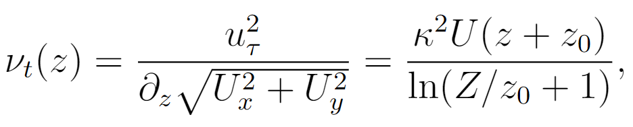
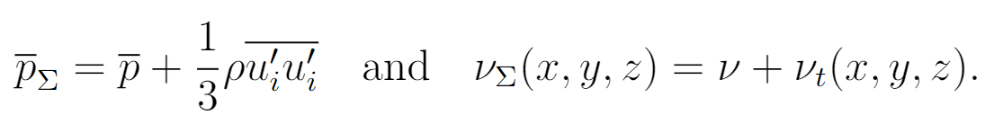
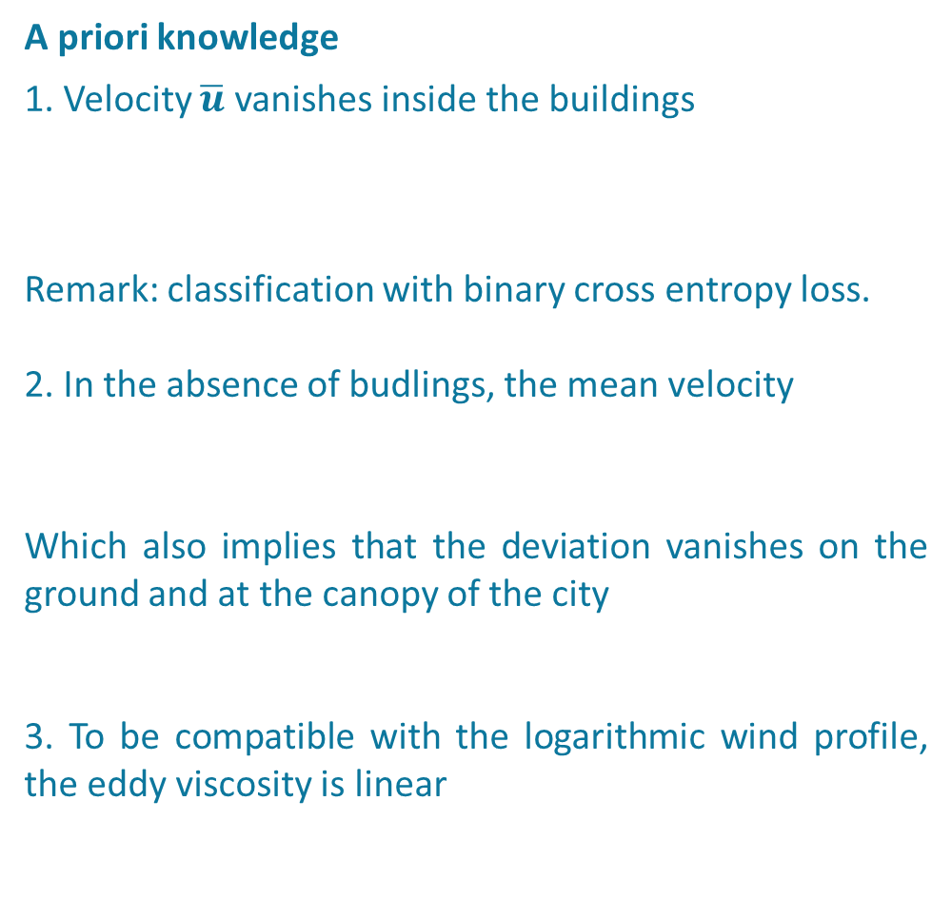
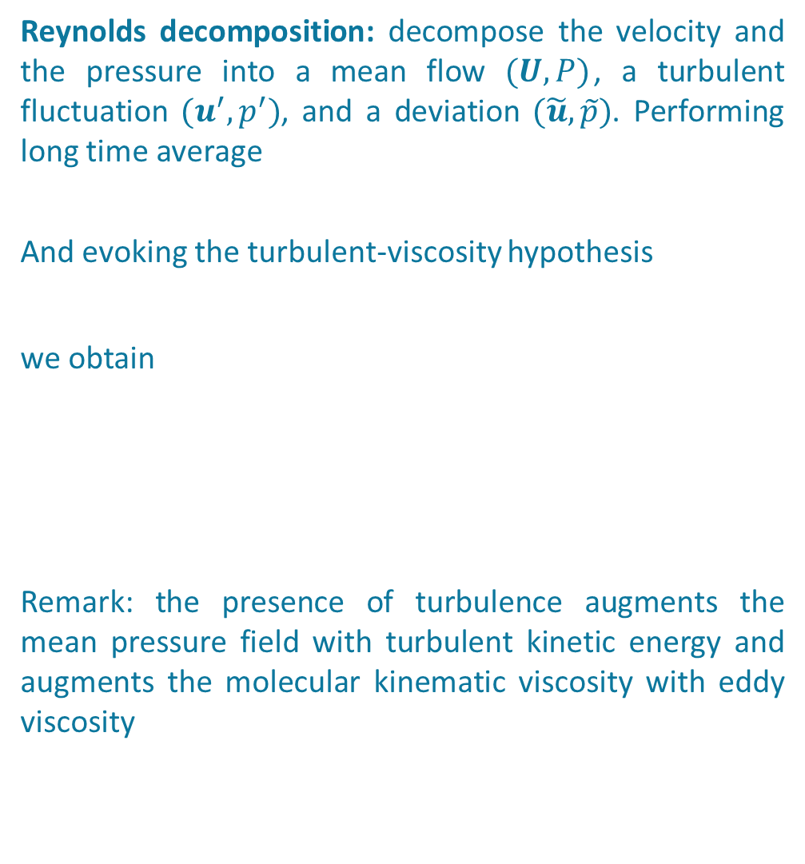
Reynolds averaged Navier-Stokes equations in urban environment
Reynolds decomposition: decompose the velocity and the pressure into a mean flow $(U, P)$, a turbulent fluctuation $(u^{′},p^{′})$, and a deviation $(\tilde{u},\tilde{p})$. Performing long time average
And evoking the turbulent-viscosity hypothesis
we obtain
Remark: the presence of turbulence augments the mean pressure field with turbulent kinetic energy and augments the molecular kinematic viscosity with eddy viscosity
A priori knowledge
1. Velocity $\overline{u}$ vanishes inside the buildings
Remark: classification with binary cross entropy loss.
2. In the absence of budlings, the mean velocity
Which also implies that the deviation vanishes on the ground and at the canopy of the city
3. To be compatible with the logarithmic wind profile, the eddy viscosity is linear

Slide 8
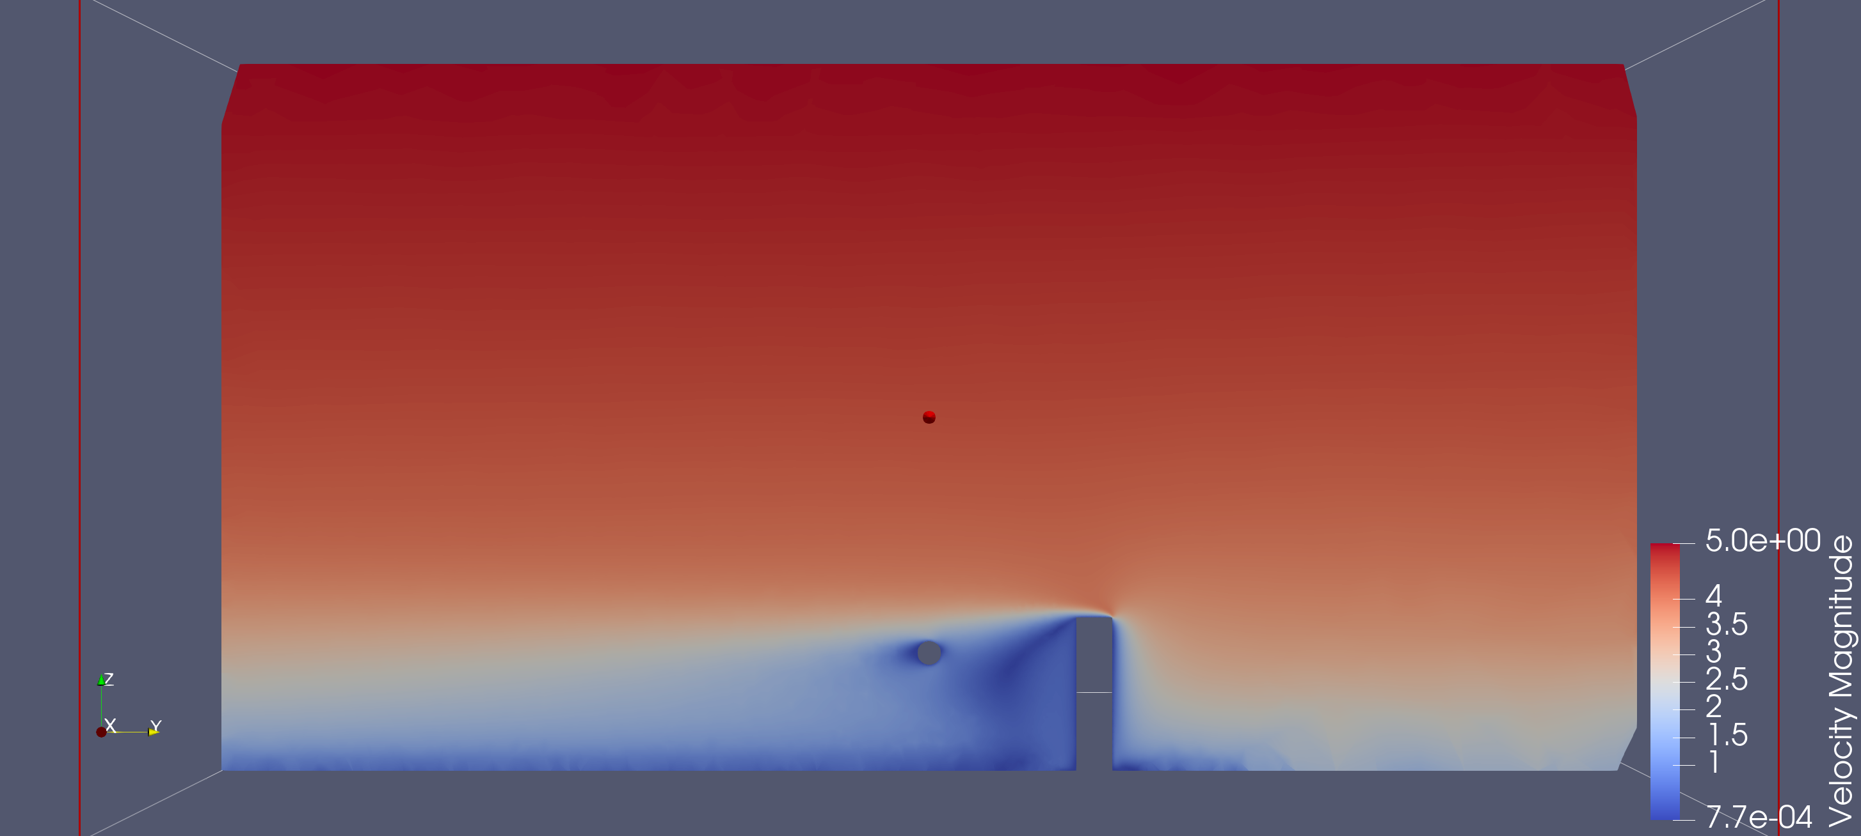
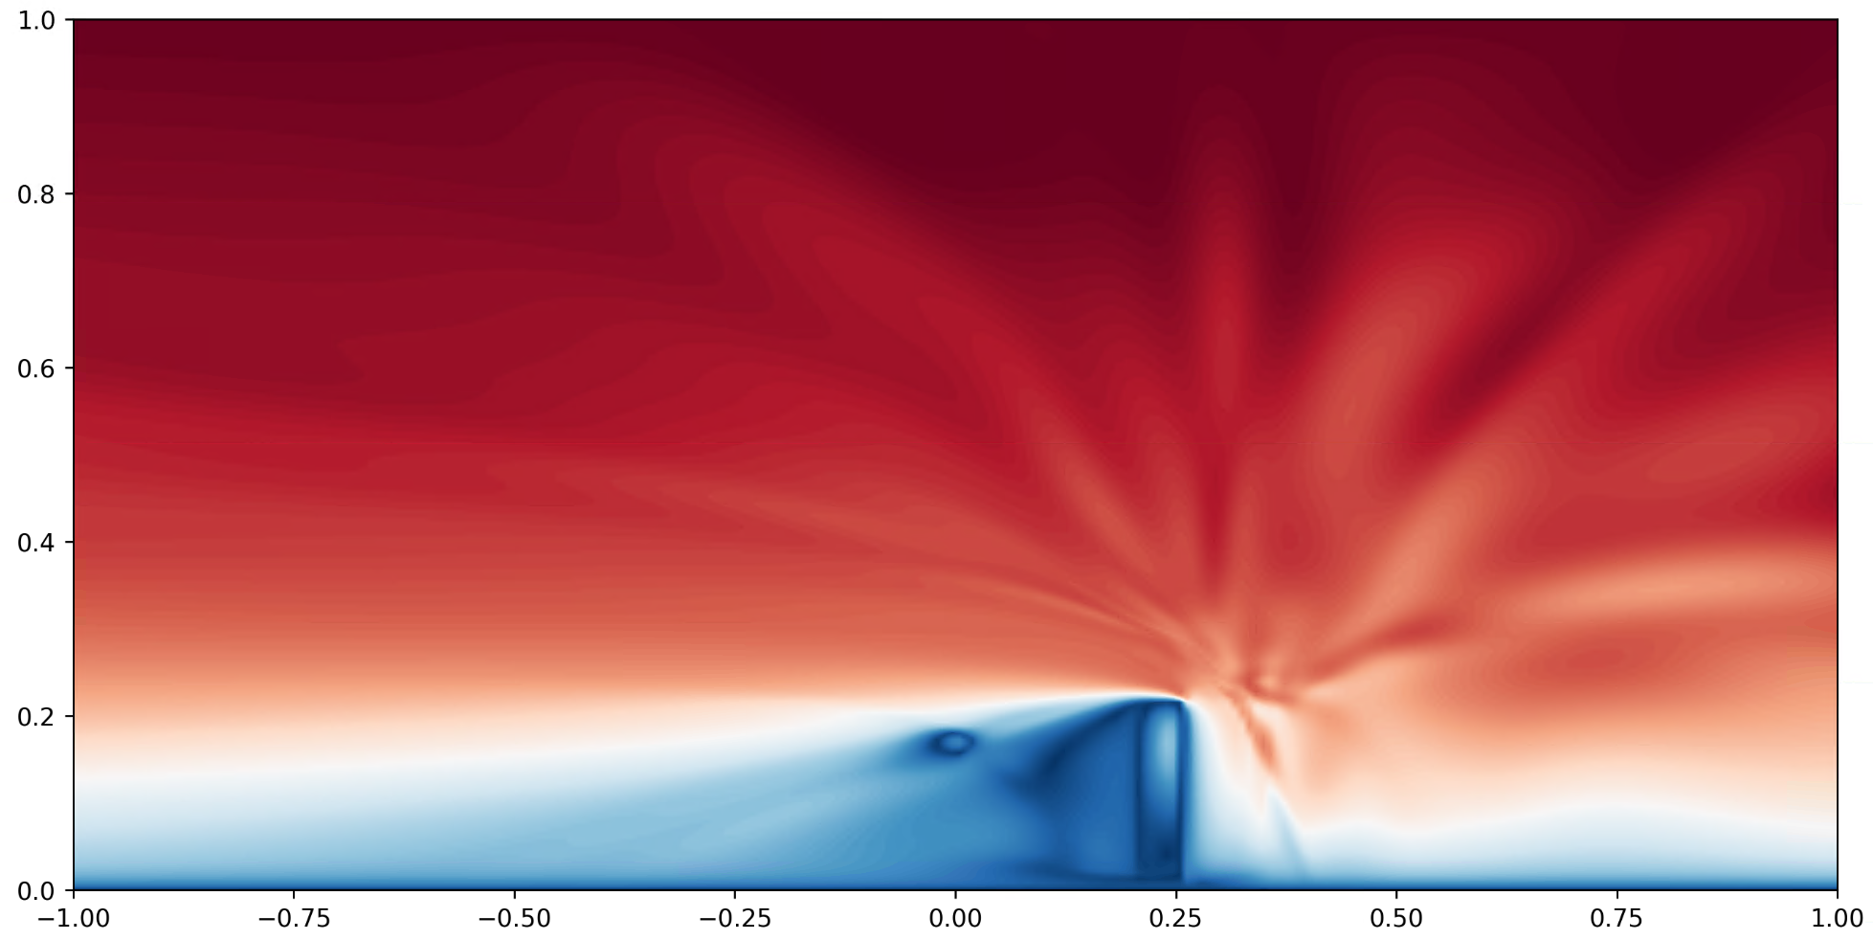
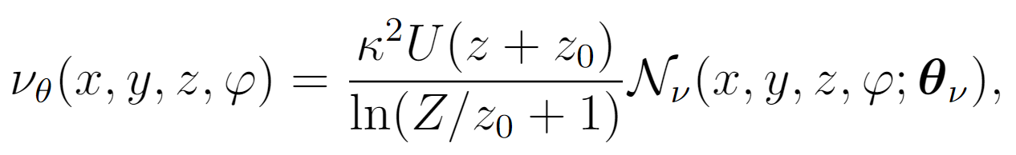
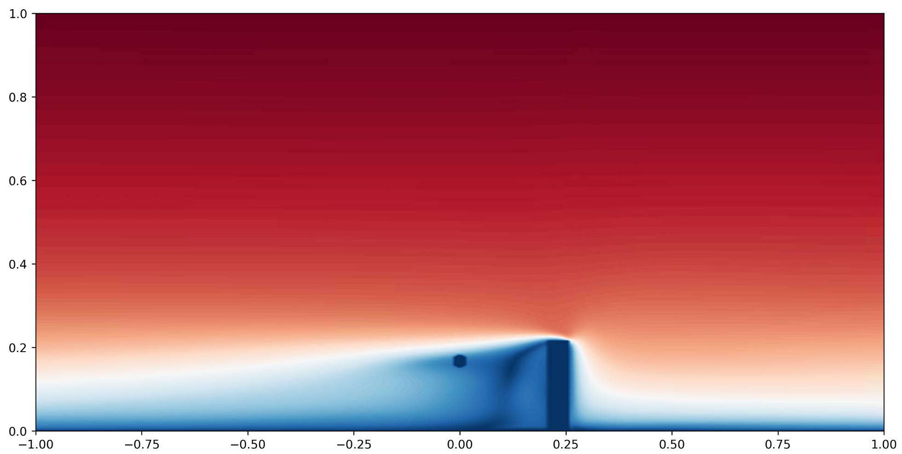
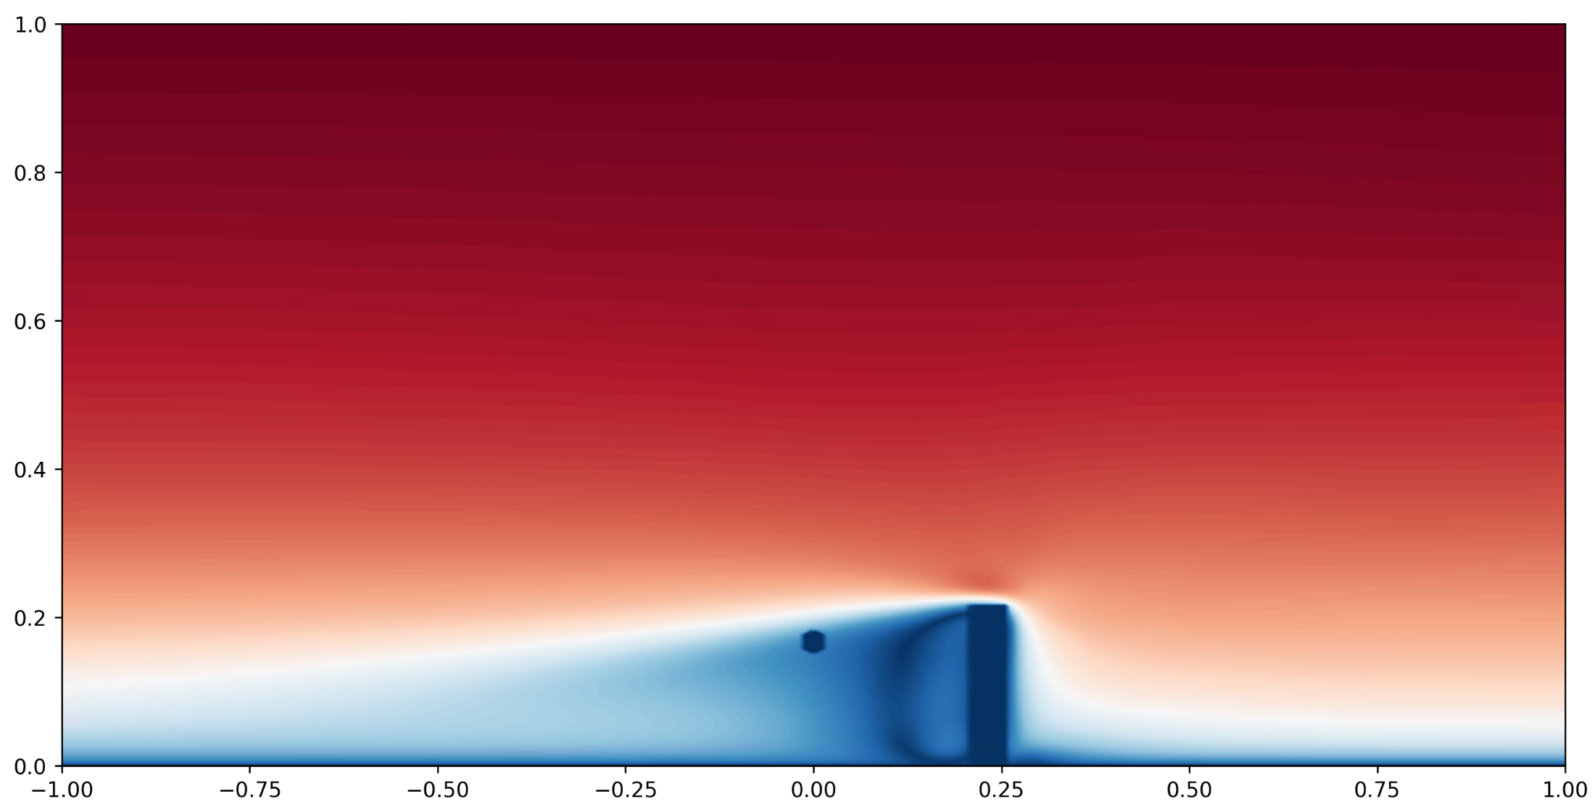
Hybrid twin synthesis
Physics are intertwined with neural networks via neural ansatz and loss functions.
Neural ansatz
such that the asymptotic behavior, the no-slip boundary conditions are satisfied by construction, leaving (i) RANS model; and (ii) incompressibility constraints to be imposed.
Remark: the incompressibility constraints can be incorporated into the neural ansatz through poloidal-toroidal decomposition
Loss functions our loss functions consist of
deviation of the approximated velocity, pressure, and eddy viscosity to reference data; and
the residue of the incompressibility constraints and RANS model.
CFD reference
NN parameterization without RANS
NN parameterization with RANS
NN parameterization with RANS, the velocity are expressed using poloidal and toroidal functions such that the velocity field is divergence free by construction.

Slide 9
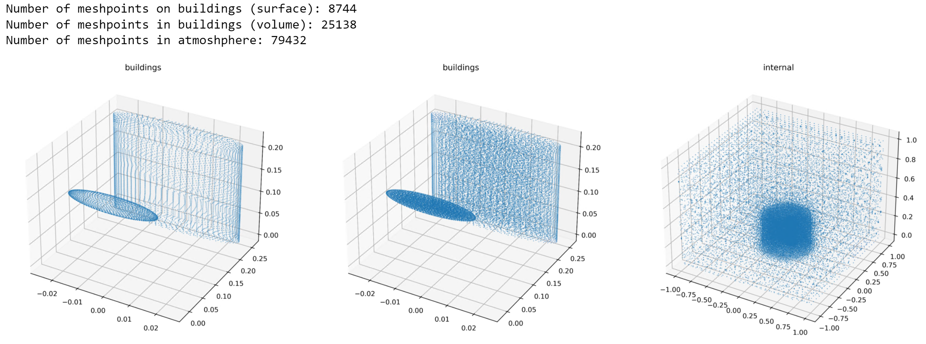
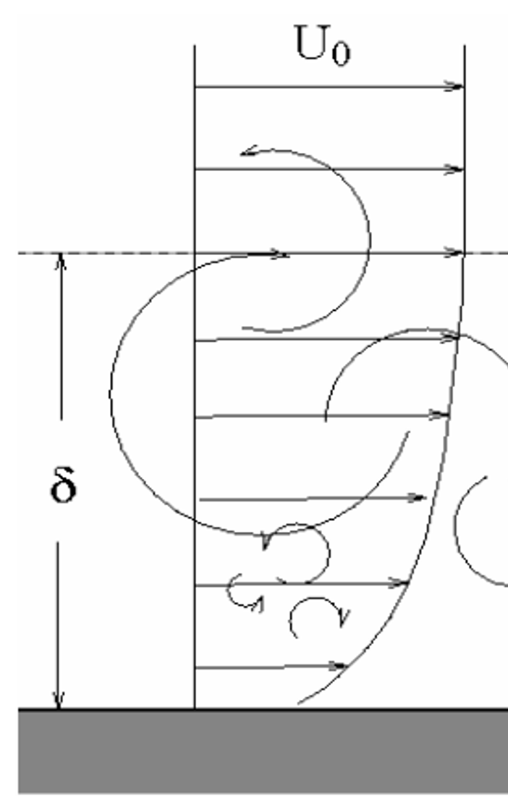
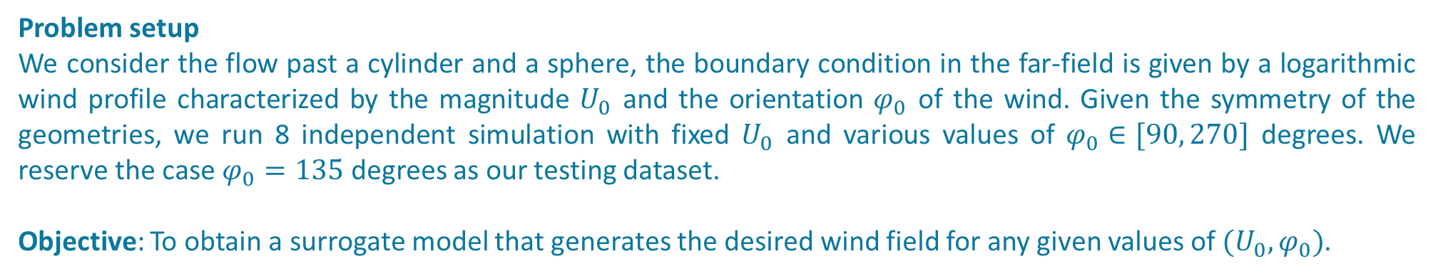
Surrogate model (demo)
Problem setup
We consider the flow past a cylinder and a sphere, the boundary condition in the far-field is given by a logarithmic wind profile characterized by the magnitude $U_{0}$ and the orientation $φ_{0}$ of the wind. Given the symmetry of the geometries, we run 8 independent simulation with fixed $U_{0}$ and various values of $φ_{0}∈[90, 270]$ degrees. We reserve the case $φ_{0}=135$ degrees as our testing dataset.
Objective: To obtain a surrogate model that generates the desired wind field for any given values of $(U_{0},φ_{0})$.

Slide 10
Conclusions
Physics can be incorporated into neural networks through (i) ansatz; and (ii) loss functions.
By exploiting self-consistency, we can (i) recover hidden physics from data; and (ii) bring regularization to the measured data.
However, the use of neural networks do not mitigate numerical challenges originated from the governing equations.
Minimizing loss functions involving differential equations using first order gradient descent method may not be optimal, especially when singularity developed in the simulation domain.
When there are multiple loss functions originated from different constraints, balancing multiple loss functions can be challenging.

